Slide 1
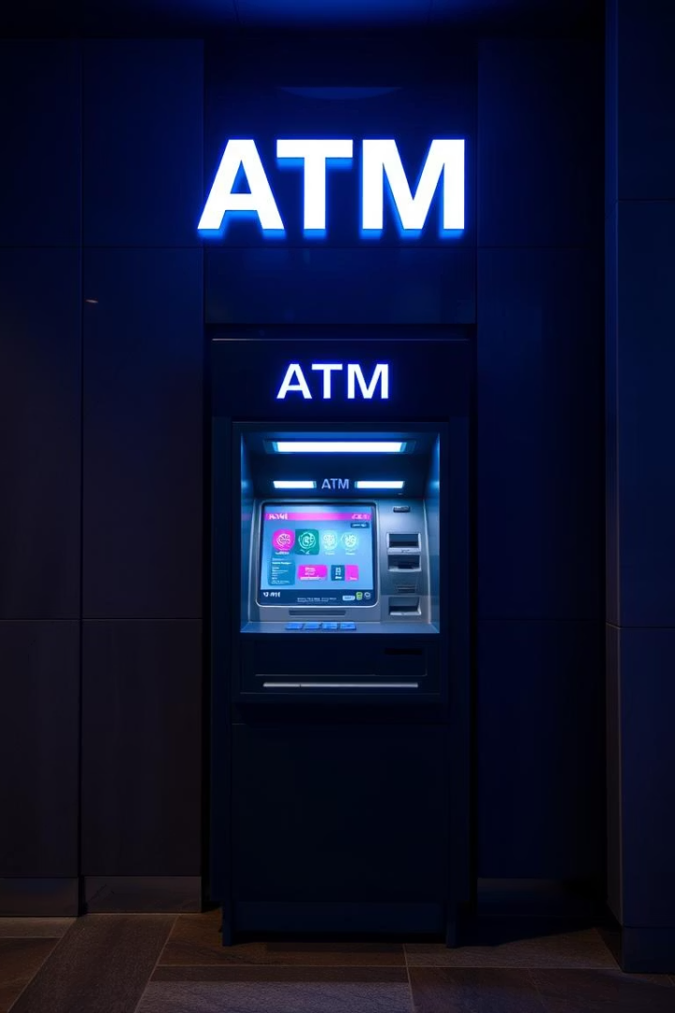
BankIslami ATM Simulator: Final Project Presentation
This presentation covers the BankIslami ATM Simulator final project, designed to replicate essential ATM functions while adhering strictly to Sharia principles. The project showcases a user-friendly interface and secure transaction handling. You will learn about our objectives, the roles of each team member, and how we achieved compliance with BankIslami’s guidelines.

Slide 2
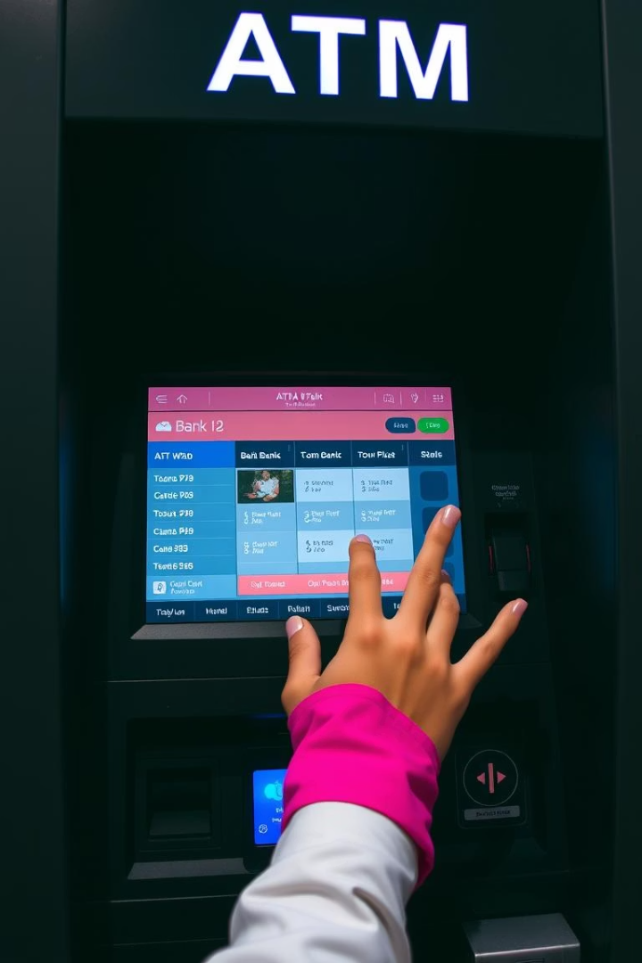
Project Overview
Simulation of BankIslami ATM
Key Functionalities
Balance inquiry, cash withdrawal, and deposit are fully simulated with accuracy.
Our software replicates core ATM transactions, emphasizing user experience and functionality.
Final Project for Course
Developed as part of the curricular requirements to demonstrate applied software engineering skills.

Slide 3

Key Features
Login
Registration
Secure Authentication using Card Number and Mpin.
Allow users to create new accounts.
Transaction
Pin Change
Handles Deposits, Withdrawal, and Balance Inquiries.
Enables users to update their MPIN securely.

Slide 4
Key Features
Balance Inquiry
Cash Withdrawal
Displays real-time account balances immediately after authentication.
Securely processes withdrawals with limits and user verification.
Deposit
Mini-Statement
Enables funds deposits with instant confirmation and record updates.
Provides a summary of the last five transactions for account tracking.

Slide 5
Technologies Used
Programming Language
Development Environment
Database
Libraries & Frameworks
MySQL 8.0 manages persistent data storage for account and transaction details.
Java 17, enabling robust object-oriented development.
Net Beans used for efficient coding and debugging workflows.
JDBC for database connectivity and Swing for building the GUI interface.

Slide 6
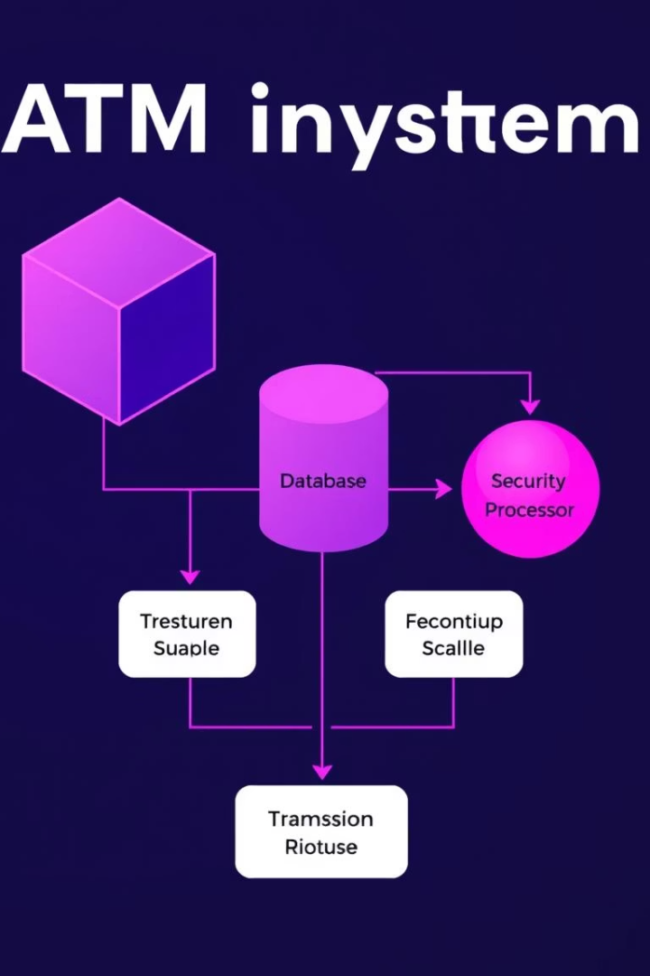




Implementation Details
Modular Design
Encapsulation of ATM functionalities into independent modules for maintainability.
Object-Oriented Approach
Classes designed for Account, Transaction, and ATM operations promoting code reuse.
Database Integration
Secure access via JDBC ensures reliable data management and transaction safety.
GUI Development
Interactive Swing components provide a realistic user experience.

Slide 7




Security Features
Transaction Logging
Session Management
Comprehensive audit trails enable accountability and traceability.
Secure user sessions protect against hijacking and unauthorized use.
Secure Login
Input Validation
16 digit card number validation and 4 digit mpin validation
Strict validation rules prevent SQL injection and other input attacks.
2
3
1
4

Slide 8

Testing and Validation
Test Coverage
Performance Testing
Achieved 95% code coverage emphasizing thorough testing.
Edge Case Testing
Evaluating response times for transactions, login authentication, and balance inquiries.
Functional Testing
Testing extreme cases such as withdrawal limits, incorrect MPIN formats, and database errors.
Verifying core features such as authentication, deposits, withdrawals, and MPIN management

Slide 9
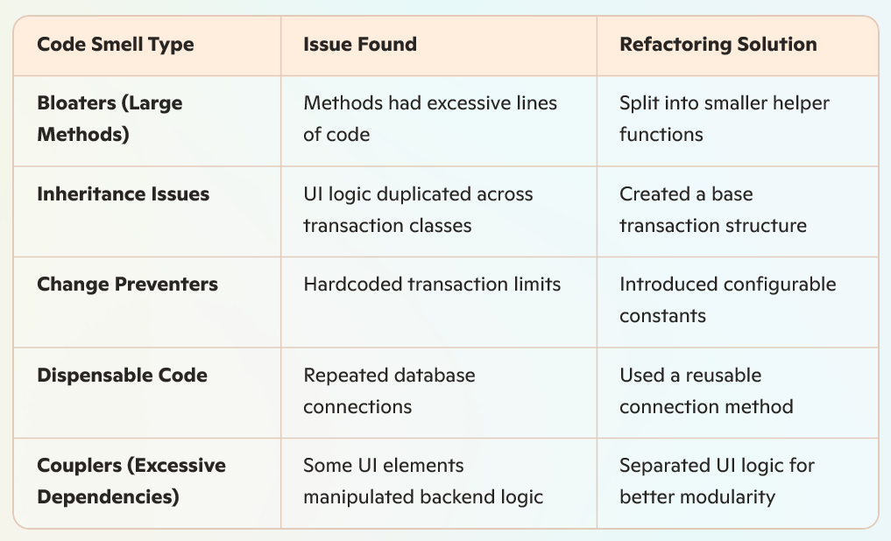
Code Smells Identified During Development

Slide 10
Refactoring Implimented
MPIN Change Bug Fix:
Issue: MPIN retrieval was incorrect, causing failed updates.
Fix: Adjusted SQL query execution to correctly fetch MPIN before update.
Improved validation mechanism for preventing incorrect MPIN mismatches.
Performance Optimization:
Reduced redundant database queries for balance inquiry.
Optimized transaction execution to prevent concurrency issues.
UI Improvements:
Fixed Mini Statement overlap issue when displaying large data.

Slide 11
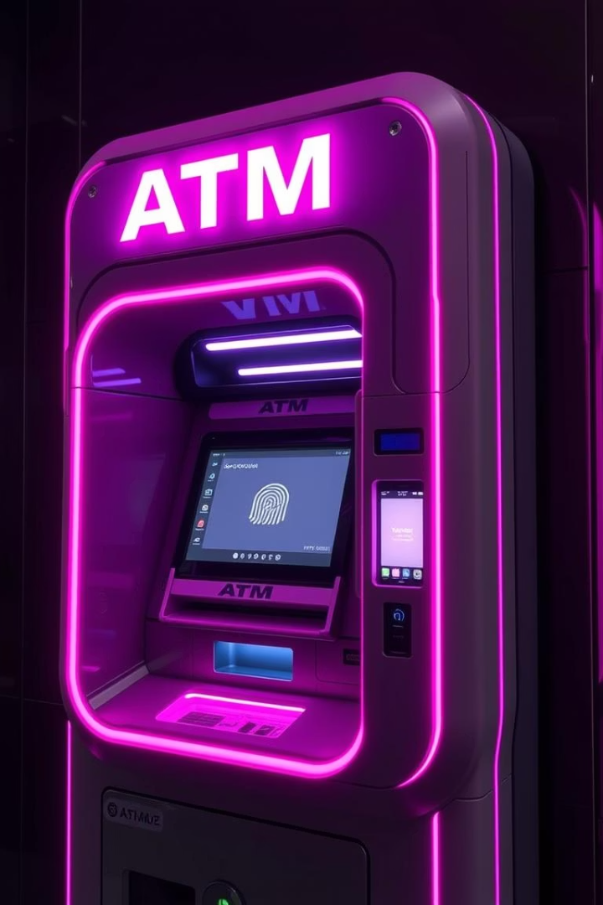
Future Enhancements
Mobile App Integration
Extending ATM functions to secure mobile platforms for convenience.
Biometric Authentication
Adding fingerprint and facial recognition for stronger user verification.
Advanced Security
Implement multi-factor authentication to enhance protection.
Expanded Transactions
Include funds transfer and bill payments to broaden service scope.

Slide 12
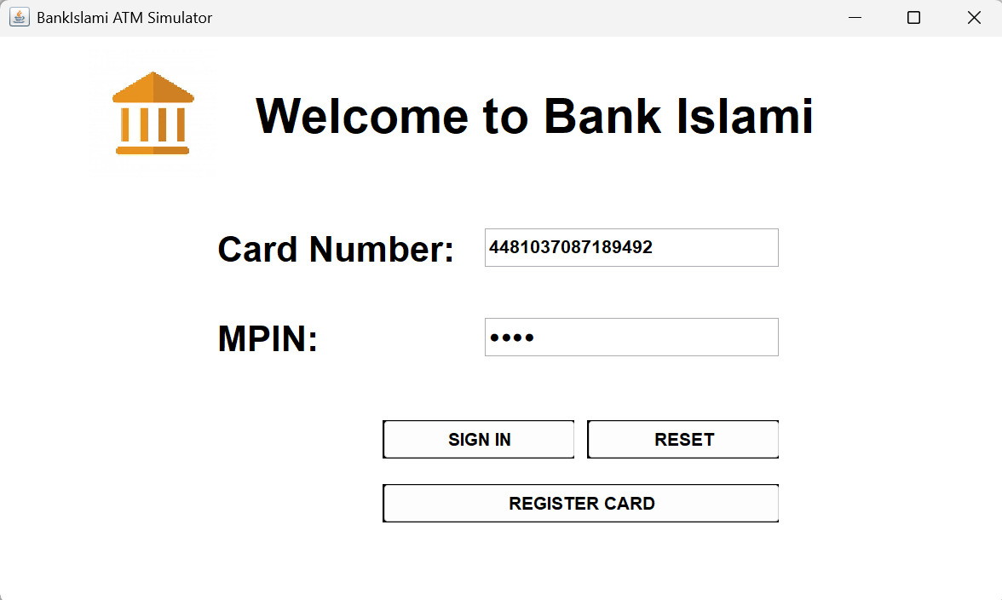

Slide 13
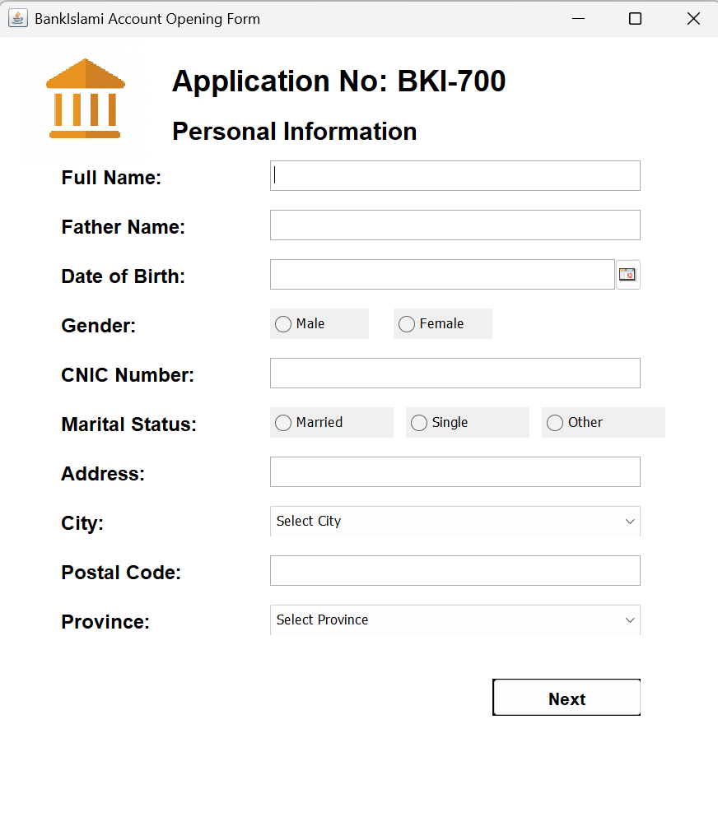

Slide 14
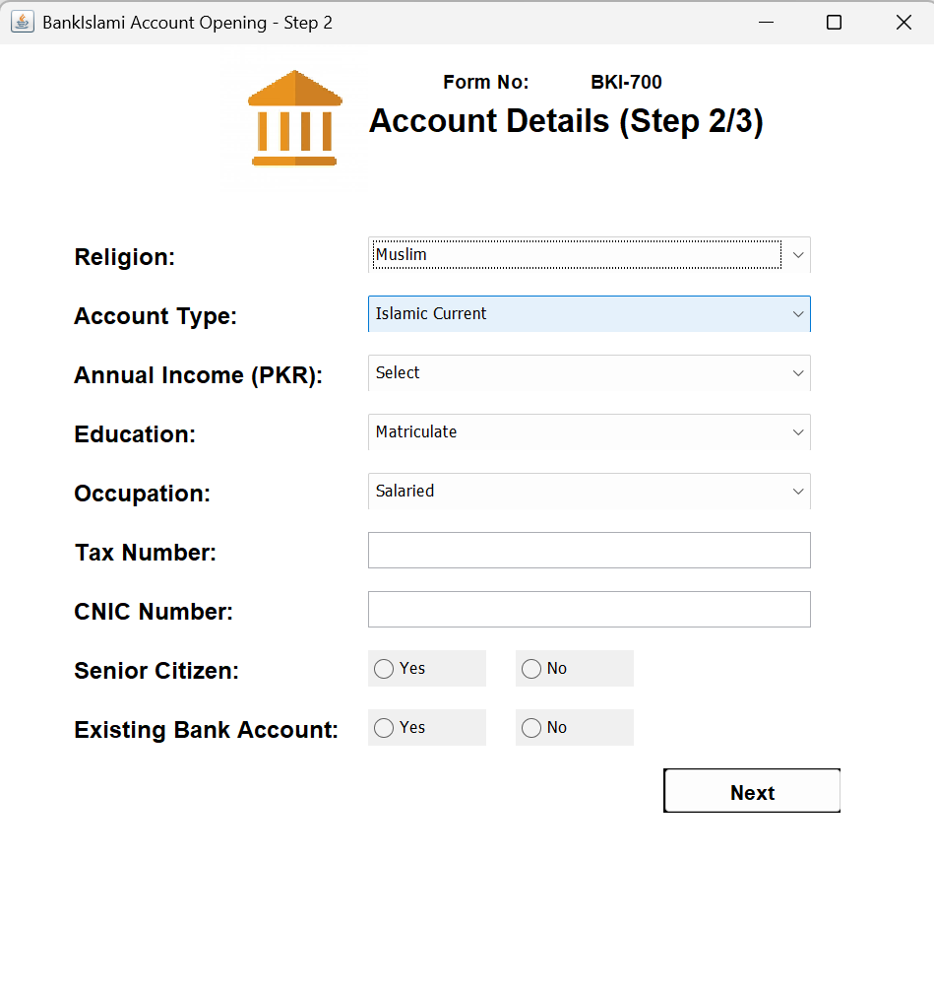

Slide 15
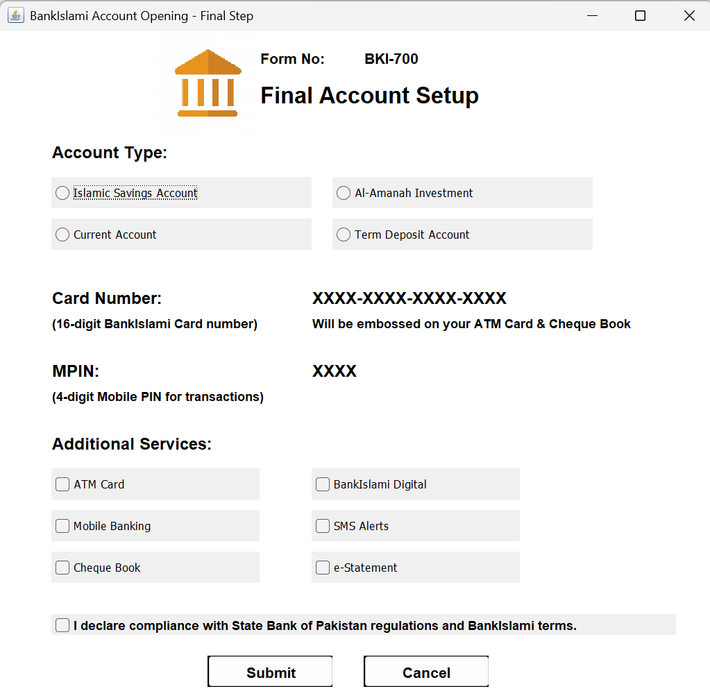

Slide 16
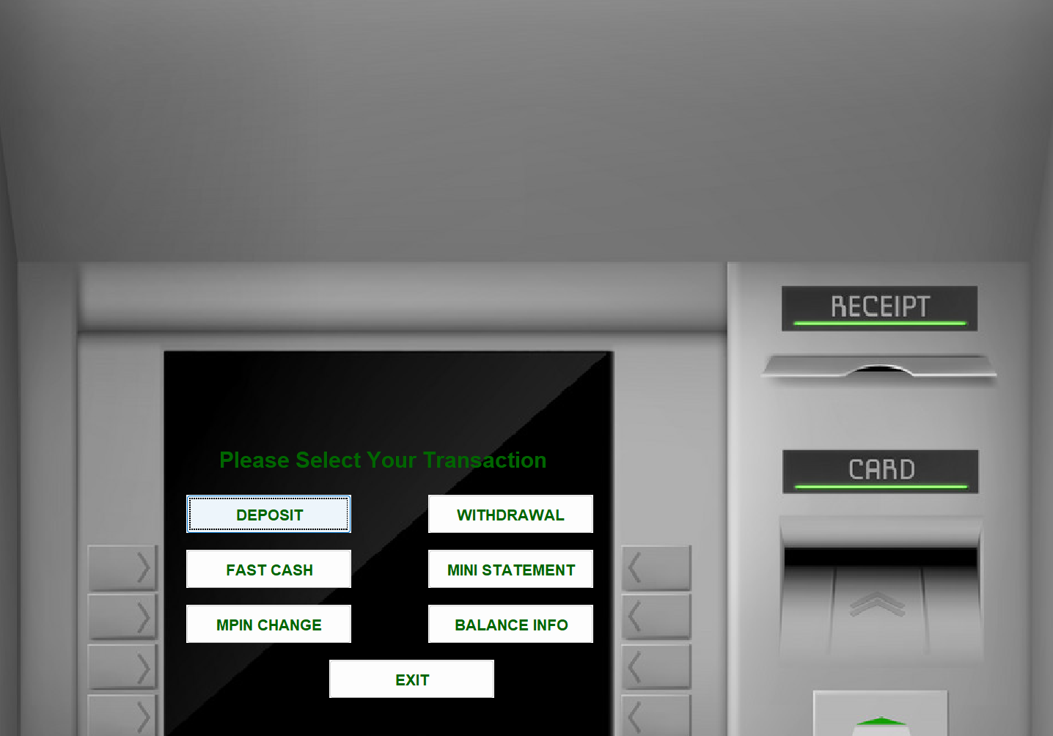

Slide 17
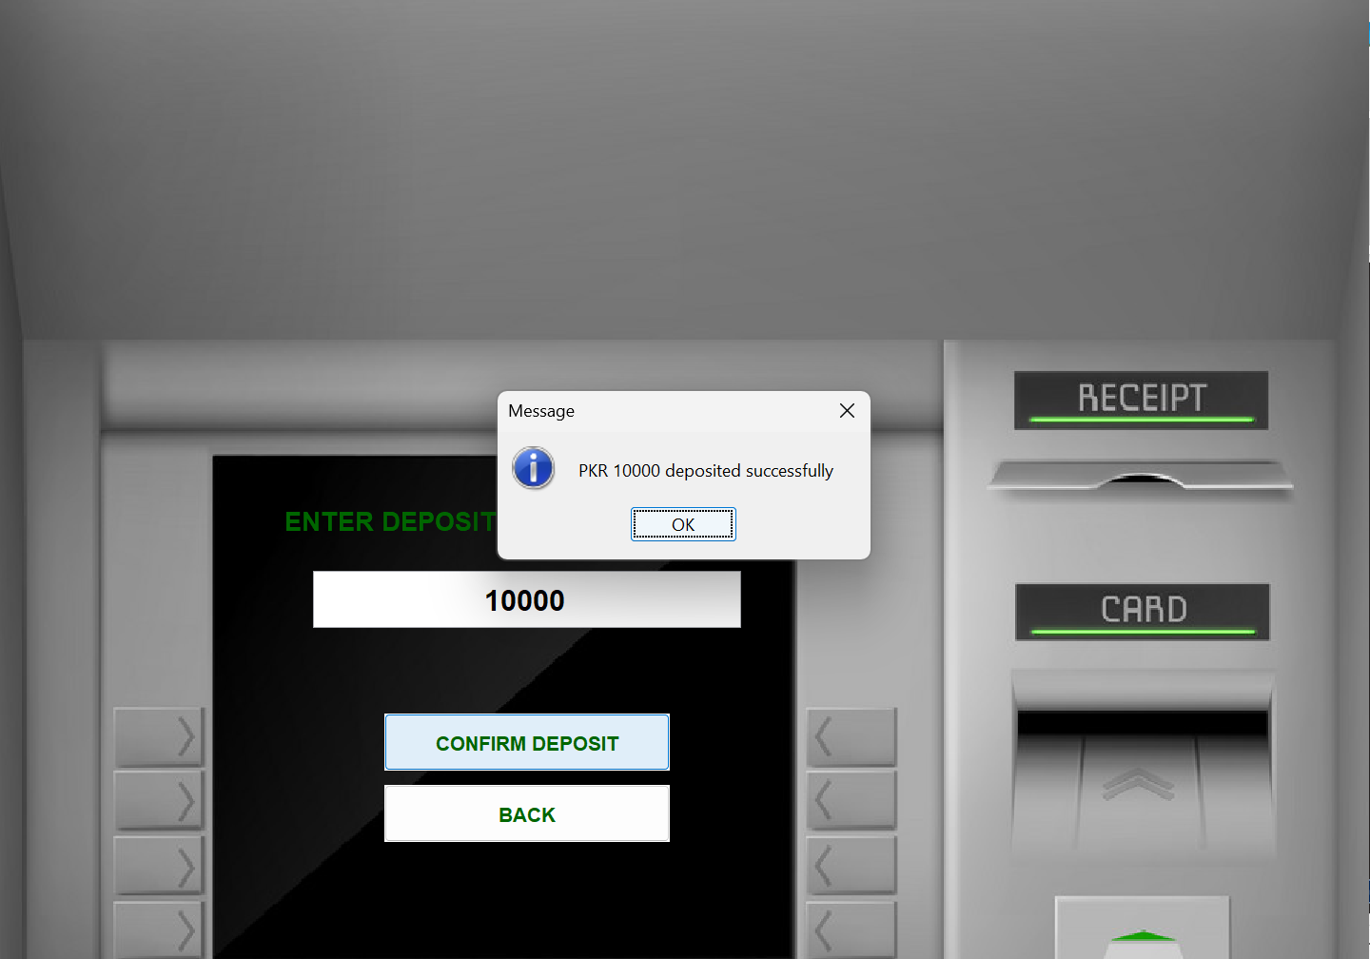

Slide 18
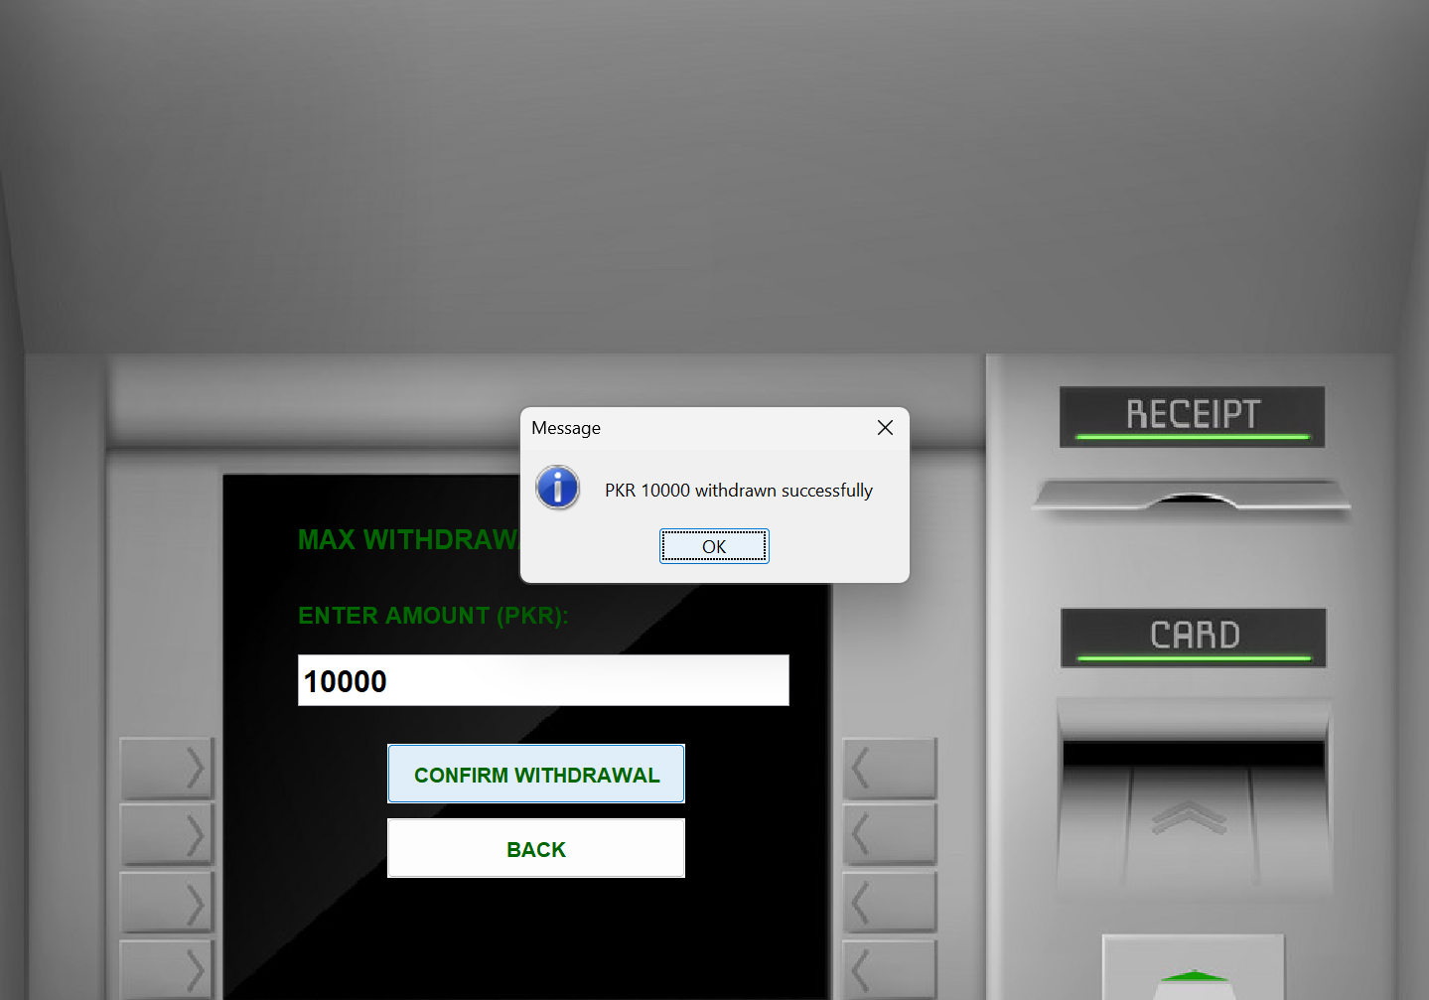

Slide 19
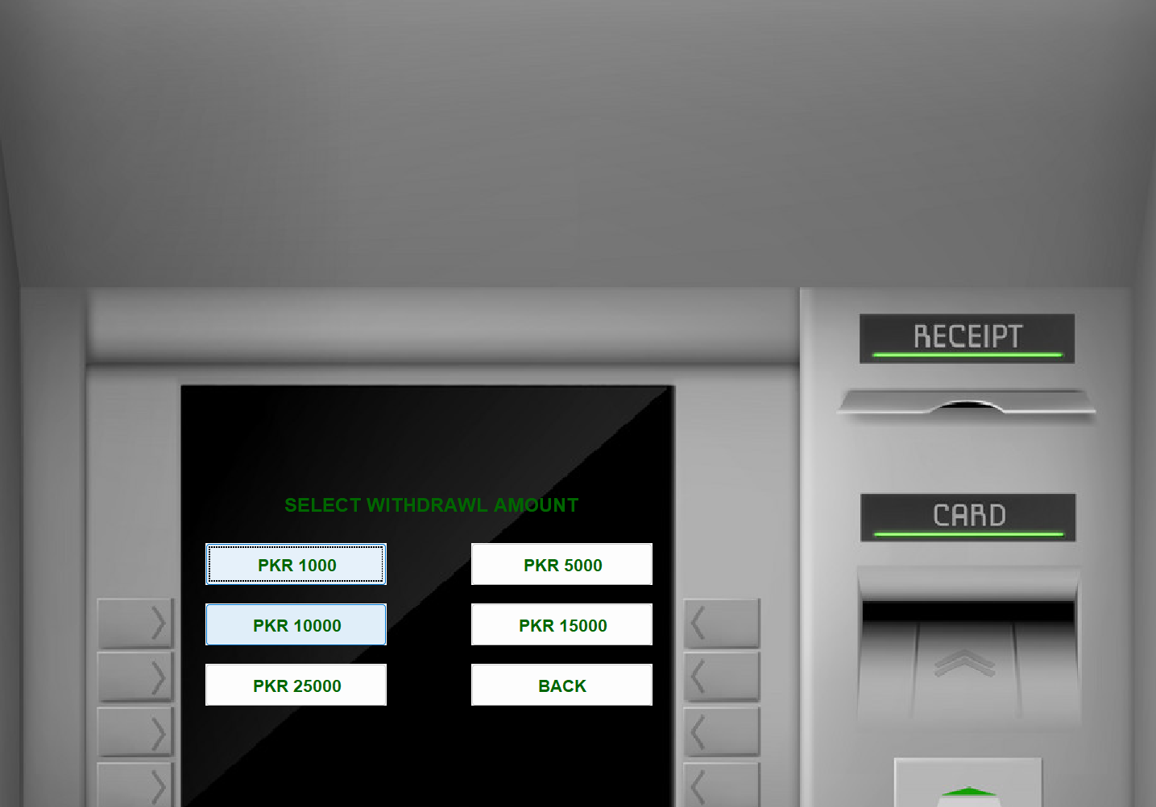

Slide 20
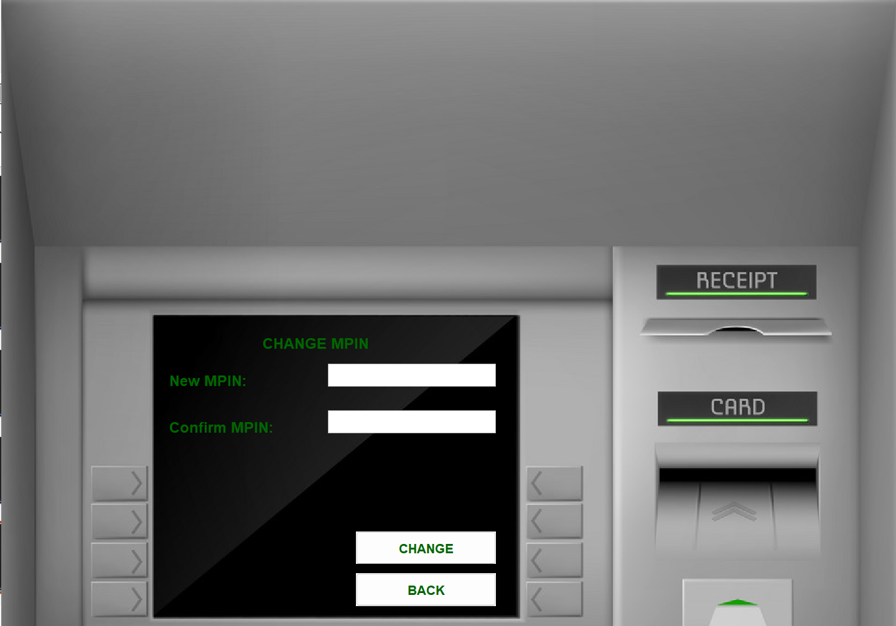

Slide 21
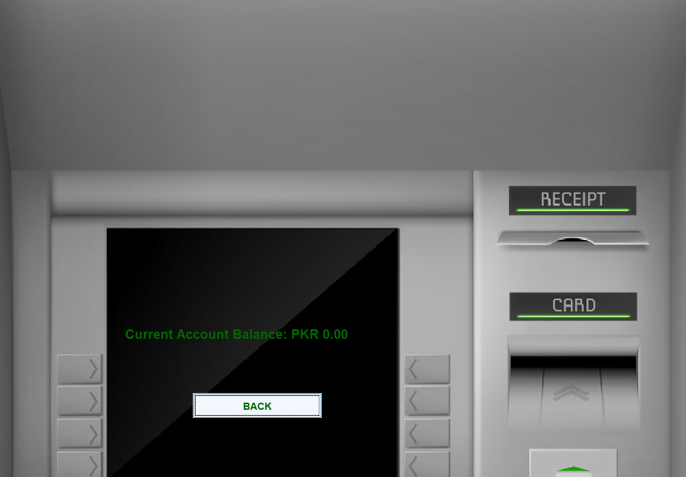

Slide 22
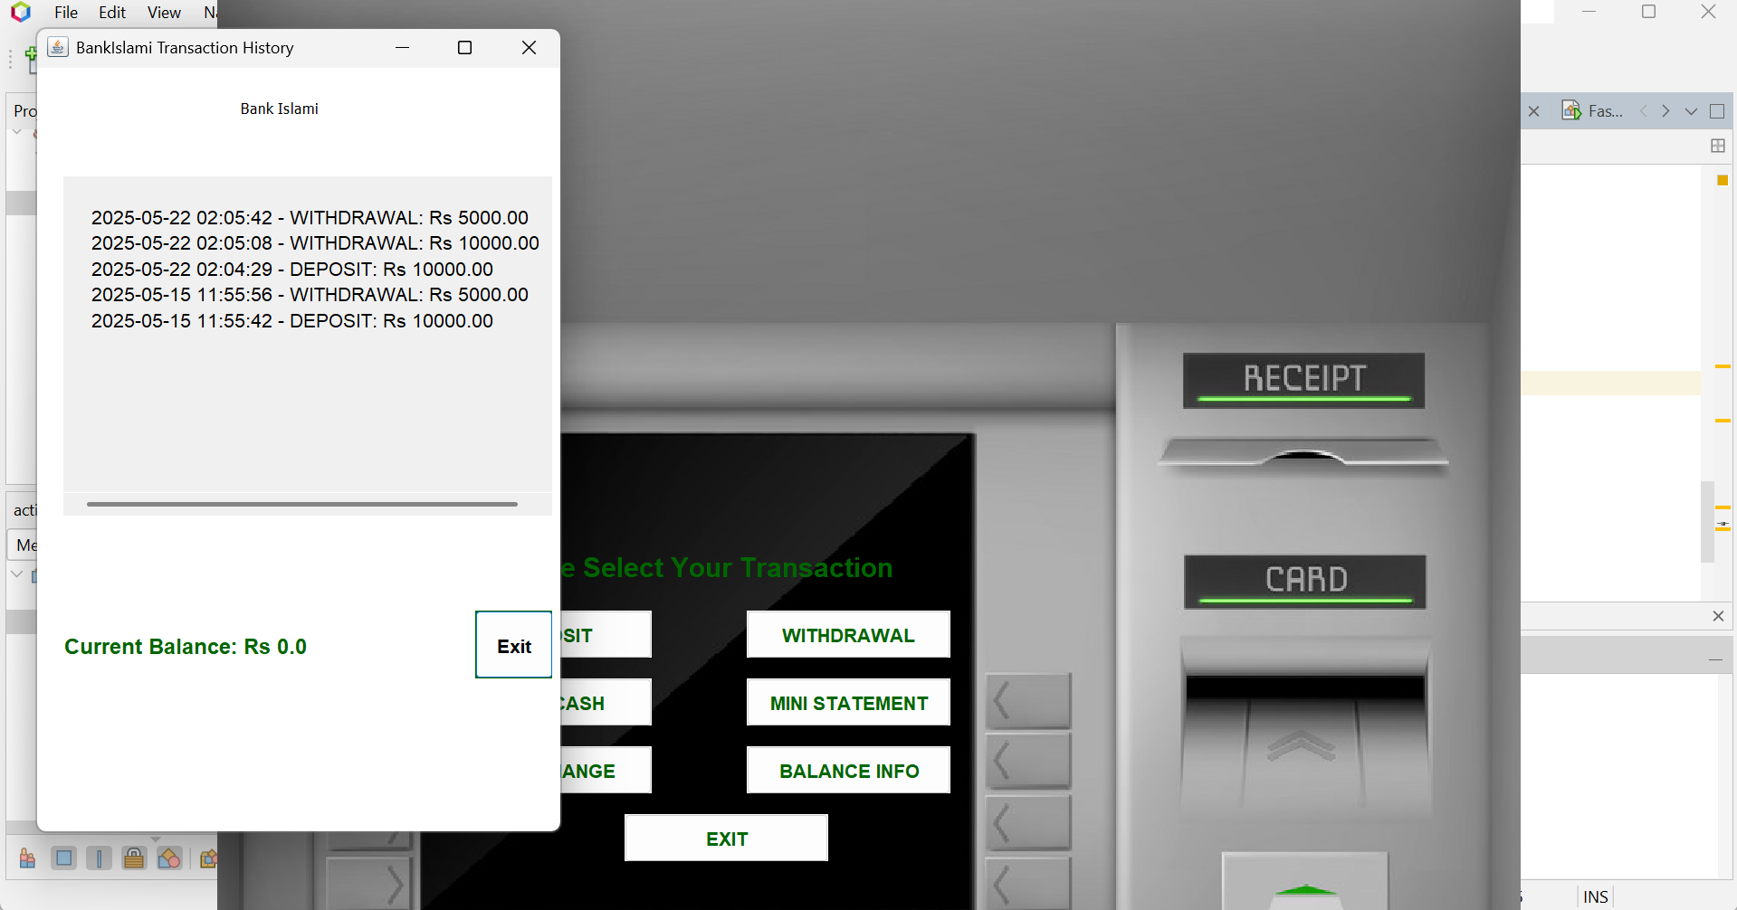

Slide 23
Conclusion
The BankIslami ATM Simulator was successfully developed demonstrating sound software engineering principles. Our focus on Sharia compliance ensured the system meets ethical banking standards.
Thank you for reviewing our project. We are proud of our achievement and committed to continuous improvement guided by feedback and emerging financial technology trends.
We have met all project objectives, delivering a secure, user-friendly interface and robust backend. Future plans target enhancements for usability and security, making the simulator more comprehensive and accessible.

